Slide 1


Ansible & SaltStack
By Joseph Lord & Edmund Butarbutar

Slide 2
Ansible: About
Ansible allows you to give commands to multiple machine for a central machine.
You don’t have to install anything on the non-central machines, only on the central machine.
This is very powerful for automation and saving time.

Slide 3
Ansible: Installation & Configuration
Installation is really easy. Make sure your machine is up-to-date.
Start by installing epel-release, then install ansible.
After installing these two, update your machine.
You now have the ansible service on your machine.

Slide 4
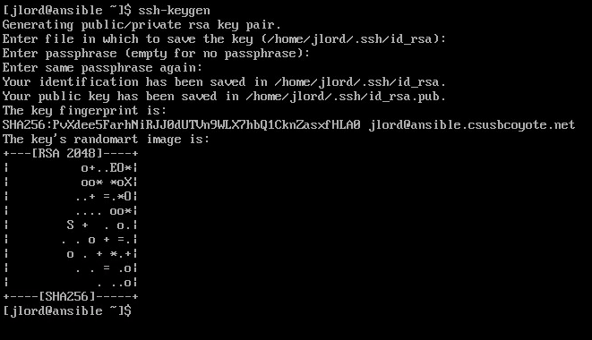
Generate ssh keys and copy then to all machines

Slide 5
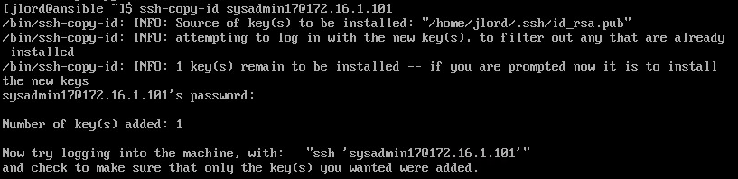
This establishes ssh trust between machines

Slide 6
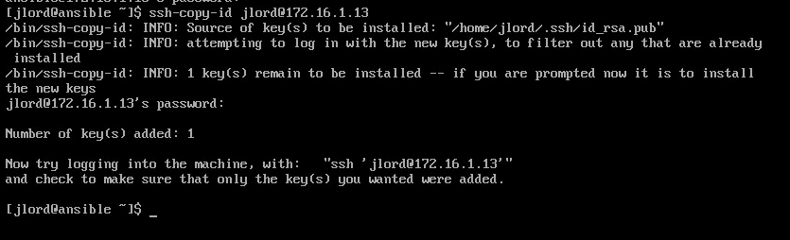

Slide 7
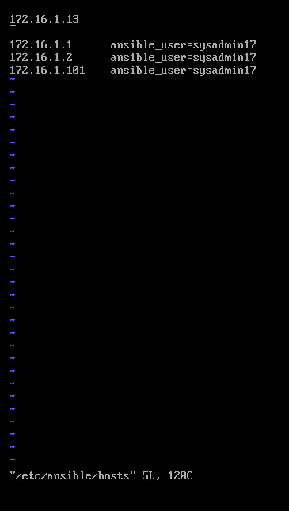
Add all machines to
the hosts file
/etc/ansible/hosts
Make sure you set your ansible_users or
Ansible might not connect to the non-central
machines.

Slide 8
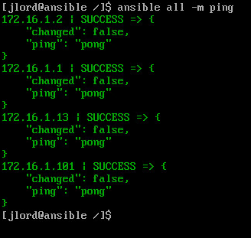
Check your connection to make sure ansible connects to all machines

Slide 9
Ad-Hoc Commands & Playbooks
You can use ansible command line, which is called Ad-Hoc, but it is mostly for making small changes.
Ansible’s power lies in its scripting mechanism called playbooks. It allows you to run multiple commands at once that can be used as many times as needed without having to rewrite it.
Playbooks are written in YAML and have a very specific notation/indentation to the code.
Detailed Info: https://docs.ansible.com/ansible/latest/index.html

Slide 10
DEMO

Slide 11
SaltStack: About
Configuration Management tool
Maintaining remote nodes in defined states. Ie. installation and running
Allows for targeting specific minions or groups of minions

Slide 12
SaltStack: Installation & Configuration
Create a Master Server and Minion Server CENTOS 7
Firewall configuration Add ports 4505 & 4506/TCP
Then install the repositiory on both Master and Minion: https://repo.saltstack.com/yum/redhat/salt-repo-latest-2.el7.noarch.rpm
Then Install Master and Minion on their server And enable the Master Server

Slide 13


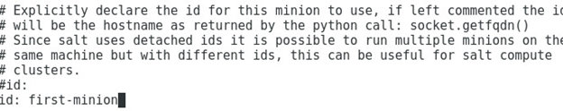
Configure the Master to communicate to Minion

Slide 14
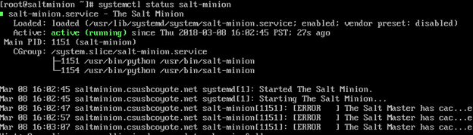
Enable the Minion Server

Slide 15
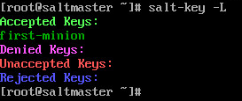
Check for communication
Now the Minion server and Master server are communicating

Slide 16
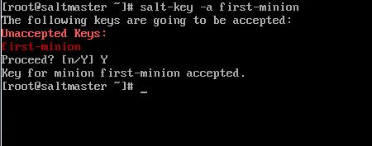
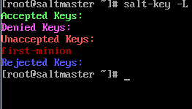
Accept Keys

Slide 17
DEMO

